Slide 1

Course Introduction
What (and how) are we going to learn?
Yordan Darakchiev
Technical Trainer
iordan93@gmail.com

Slide 2
Table of Contents
Course objectives
Prerequisites
Curriculum
Course schedule
Trainer
Lecture format
Final exam
Some learning resources

Slide 3
Course Objectives
Working with data in a disciplined way

Slide 4
Course Objectives
Learn how to apply the scientific method to
Ask the right questions
Obtain and clean up data
Explore and analyze data
Make the correct conclusions
Write your own research
Learn how to create evidence-based, reproducible research
Learn how to create a complete solution
Incorporate best practices in software design and science
Communicate and compare results with the community

Slide 5
Prerequisites
Intermediate English
Programming Basics
Math Concepts
Have basic logic and intuition
Understand what is written on the slides
Scientific Mindset
Be open to (and not afraid of) challenges
Software development experience is a plus
Know some algebra and statistics (and a little bit of calculus)
Some familiarity with Python is required

Slide 6
Course Format Details
Curriculum, schedule, trainer, lecture format, exam

Slide 7
Curriculum
Course introduction
Data acquisition
Data tidying and cleaning
Data visualization. Exploratory data analysis
Case studies, part 1: Images and text
Case studies, part 2: Spatial data and networks
Modelling basics: regression models
Best practices in software and science
Exam preparation: end-to-end project
Course summary: data science in the wild

Slide 8
Course Schedule
Lessons
9 lectures x 4 hours each
Homework
4 hours+ – the more, the better
Quiz – 0,25-0,5 hours
Questions to check your understanding
Lab – 1-6 hours
Problems related to real-life data science
Extracurricular activities: 0+ hours
Practical exam
5-20+ hours

Slide 9
Time Allocation
Course
23 June – 18 August 2022
Exam
Group 1: 28 August 2022, 09:00 – 18:00, GMT+3
Group 2: 4 September 2022, 09:00 – 18:00, GMT+3
Retake exam
11 September 2022, 09:00-18:00, GMT+3

Slide 10
Final Exam
Quiz (theoretical exam)
10 questions for 30 minutes
Practical project
Work on your own
No teams allowed
Present your results (documentation, code, etc.) in a limited amount of time
Work on a given assignment
Assignment release time: at second lecture
Perform research
Scientific papers, community forums, etc.
Analyze the data
Write code
Communicate the results

Slide 11
Grading Scheme
Quizzes: up to 10%
Due date: at the end of the course
Labs: up to 10%
Due date: at the end of the course
Final exam: up to 80%
Theoretical exam (quiz): 30% (24% of total grade)
Practical exam (project): 70% (56% of total grade)
Develop at your own pace
Upload deadline: Friday before the exam date; 12:00 PM
Project defense
Online: Sunday, according to schedule
Discord / Facebook group activity: bonus up to 10%
Other bonuses: up to 10%

Slide 12
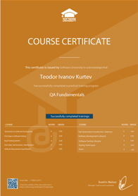
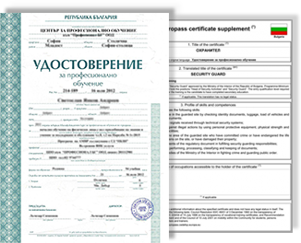
Grading and Course Certificates
All students will be graded on a scale from 2,00 to 6,00
The same way the standard grading in Bulgaria works
Everyone who scores ≥ 5,00 (total) will get a certificate from SoftUni
Everyone who scores $≥$ 3,00 (on both theory and practice) can get a MoES certificate as well
You need to apply explicitly within a limited time

Slide 13
Why bother?
Starting point for a new career or continuing education in your current field
Career assistance
The SoftUni career center will help you find work
Official and recognizable
Employers value certificates
Proof of hard work :)
Shareable and verifiable
We make sure that everyone who scores $≥5,00$ knows what they're doing :)

Slide 14
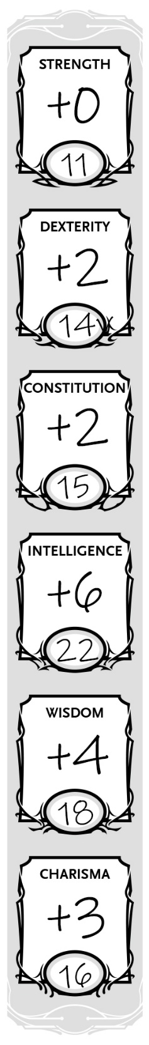
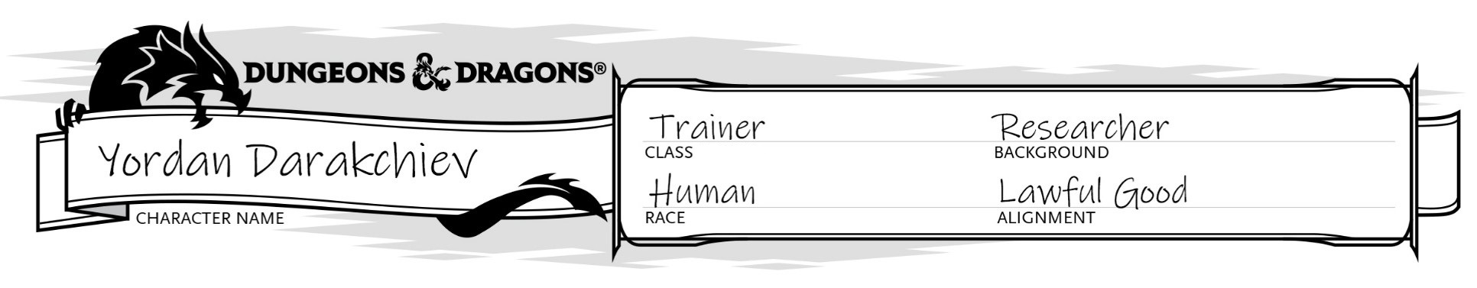


Programmer
.NET / full-stack Web developer
Machine learning engineer
Multiple projects, mainly image processing
Trainer
Various programming courses
Scientific (and popular) lectures
Scientist / Enthusiast
BSc & MSc in Astrophysics
Currently pursuing a PhD
Machine learning
Research
Teaching
Software engineering
Python
C#
JavaScript

Slide 15
Learning Resources
Learn more and share your knowledge

Slide 16
SoftUni Resources
AI module page
Course page
Facebook group
Discord server
Guidelines
Ask and answer questions
I will try to answer your questions as well
Post what you've learned
Links to resources, code snippets, ideas, tips and tricks
Share your problems (homework or not) and help solve them
Create and maintain a community

Slide 17
Online Resources
Books
"How not to be wrong" – Jordan Ellenberg
"Python Data Science Handbook" – Jake VanderPlas
"Python for Data Analysis" – Wes McKinney
… and anything else you can find
Websites
Khan Academy
Communities: Kaggle, Quora, Stack Exchange
Online courses: Coursera, edX, MIT OCW, Stanford, etc.
YouTube
AsapSCIENCE, Veritasium, Vsauce, TedEd, Daniel Shiffman, CrashCourse, Numberphile, Computerphile, Vi Hart, 3Blue1Brown, blackpenredpen, Mathologer, and many more

